Slide 1

FHIR Testing and Touchstone
Presenter:
Richard Ettema
FHIR® Certified Implementer
Lead Consultant, AEGIS.net, Inc.
richard.ettema@aegis.net
Notes:
Introduction of presenter

Slide 2
Goal of Session Two
Present the FHIR Testing framework
Introduce Touchstone:
User registration
Account setup
Test system setup
Test execution (demo)

Slide 3
FHIR Testing Framework
To ensure interoperability between applications claiming conformance to the specification, a testing framework has been established within the FHIR specification.
This framework defines the TestScript resource as a natural language, computable format of a test case.
It provides a defined test methodology for the FHIR specification which can be used to validate interoperability across FHIR server and client implementations.

Slide 4
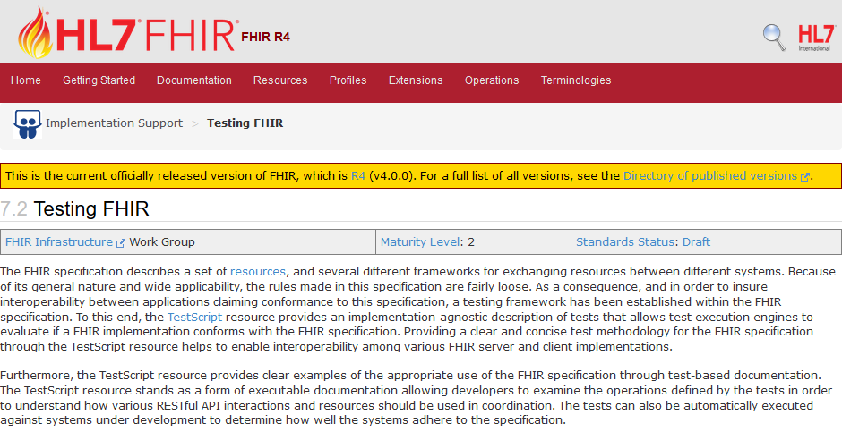
FHIR Testing Framework
http://hl7.org/fhir/testing.html

Slide 5
FHIR TestScript Resource
The TestScript resource represents an executable test definition for examining the results of FHIR RESTful API interactions.
A TestScript example would be a set of tests that exercise a certain function, such as Patient Search, and validating the responses. For this example we require:
Patient resource(s) required to complete this test
A setup procedure to create those Patient resource(s)
The tests which execute the functions being exercised & evaluate the results
A setup or tear-down procedure to initialize or clean up the test data

Slide 6
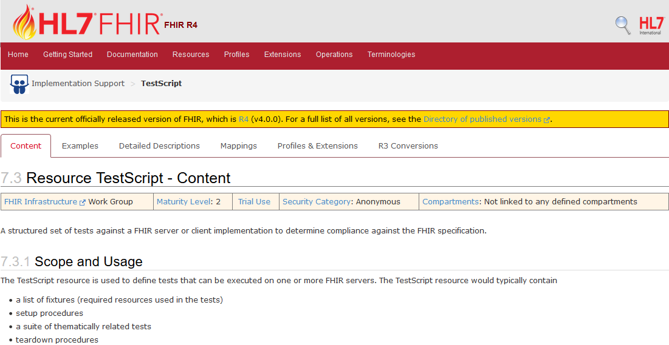
TestScript Resource
http://hl7.org/fhir/testscript.html

Slide 7

Test Engine Workflow
Pre-Processing
Determine whether or not the TestScript interactions match the capabilities of the system under test.
Setup Execution
Optional operations that prepare the system under test for subsequent test execution.
Test Execution
Execute and record each test’s operations and assertions.
Teardown Execution
Optional operations that revert the system under test to its pre-test state.
Post-Processing
Cleanup of test execution data and collection of test results.
http://hl7.org/fhir/testing.html#execution

Slide 8
Pre-Processing Capability Based Testing
The test engine will use the CapabilityStatement of the system under test to determine how to process a TestScript.
If the TestScript defines the testing of capabilities that the system under test does support, the test engine will continue the workflow process.
If the TestScript defines the testing of capabilities that the system under test does not support, the test engine should allow the TestScript to be skipped.

Slide 9
Test Execution Executing Operations
Test execution consists of two action types:
operation: The FHIR RESTful API interaction to be executed.
assert: The rule that is evaluated against the results of the operation. If true, the assert passes.
Key concept: The operation is always executed regardless of whether or not an assert follows.

Slide 10
TestScript Operations FHIR Interactions
Instance Level Interactions
Read (GET)
Vread (GET)
Update (PUT)
Patch (PATCH)
Delete (DELETE)
History (GET)
Type Level Interactions
Create (POST)
Create via Update (PUT)
Search (GET)
History (GET)
Whole System Interactions
Capabilities (GET/OPTIONS)
Batch/Transaction (POST)
History (GET)
Search (GET)
Extended Operations
http://hl7.org/fhir/operationslist.html
Base Operations (All Resources)
Operations Defined by Resource Type

Slide 11
Asserts Conditions, Rules or Expressions
An assert acts on the immediately preceding operation.
It states a condition, rule or expression that will be evaluated against the executed operation context.
Asserts provide support for:
Evaluation of both the inbound request or outbound response
Complex and simple evaluation of HTTP headers and response codes
Operators for equality, relational comparison, containment, etc.
Expression language support for XPath, JSONPath and FHIRPath
Payload comparison to defined fixtures (static or dynamic)
Payload validation against defined FHIR profile(s)
Plus a whole lot more…

Slide 12
Recap: FHIR Testing and TestScripts
FHIR defines a Testing Framework as part of the specification
Test Engines should follow a prescribed Workflow
TestScript Resource Type provides a complete, executable test definition
Support for the entire FHIR RESTful API (Operations)
Support for Evaluation of Extensive Conditions, Rules and Expressions (Asserts)

Slide 13

Discussion (Q & A)
Notes:
Notes– try to keep Q&A to 5 mins. Additional discussion can be held at breaks, lunch, or after class. Also keep in mind that some of the questions may be answered in later sessions.

Slide 14
Introducing Touchstone
Touchstone is an easy-to-use testing platform for health information exchange that implements the FHIR Testing Framework architecture.

Slide 15
Touchstone
Is available as a publicly accessible cloud-based testing platform
Provides automated, internet-based interoperability testing of the HL7® FHIR® specification
Tests the capabilities of and interoperability between both FHIR Server and Client implementations
Is a blend between Test-Driven-Development (TDD) methodologies and Natural Language Processing (NLP) TestScripts

Slide 16
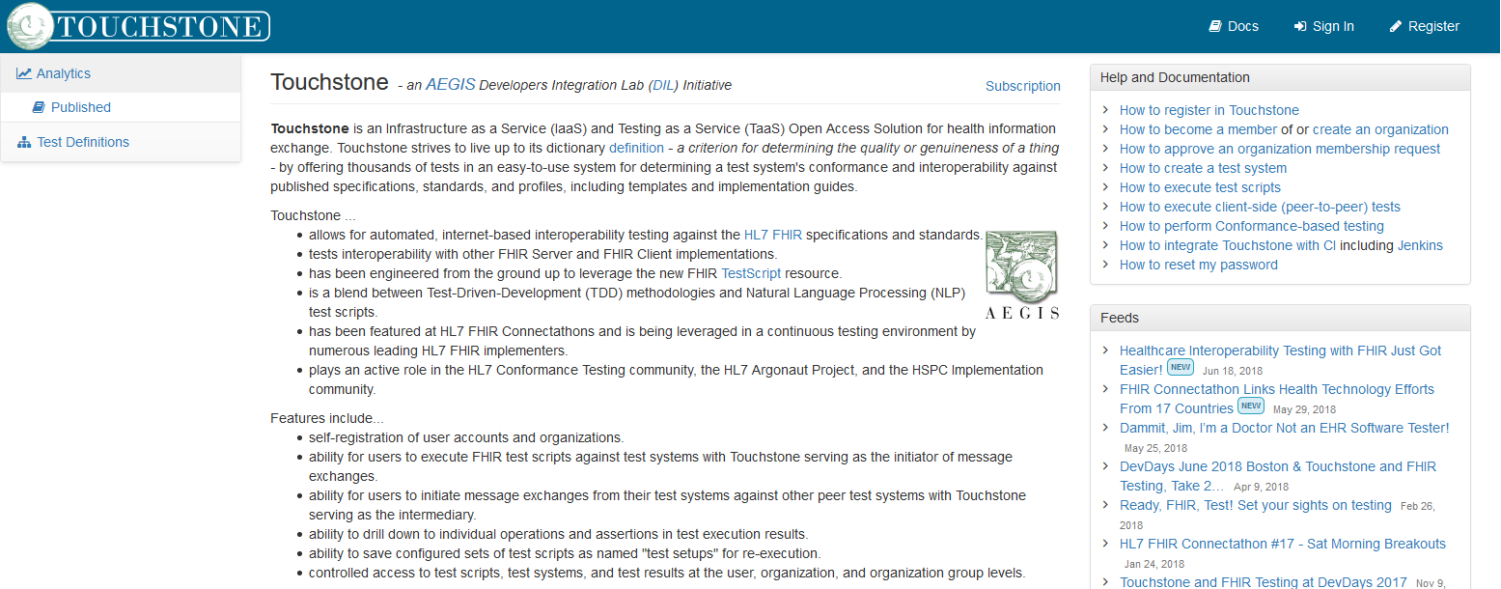
Touchstone Landing Page
www.touchstone.com

Slide 17
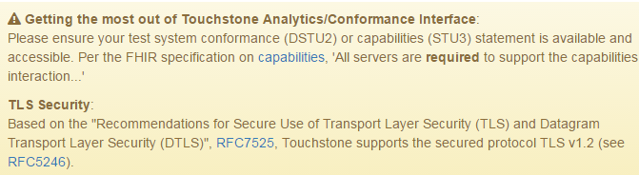
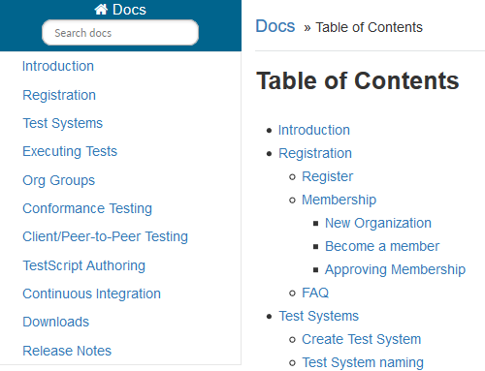
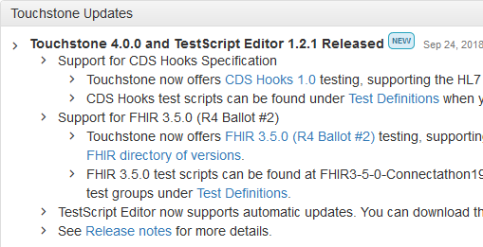
Touchstone Landing Page
Alerts: Important usage information
Online Documentation: User Guide and How-Tos
Touchstone Updates: Describes significant released version updates

Slide 18
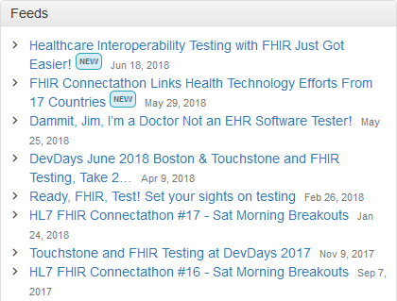
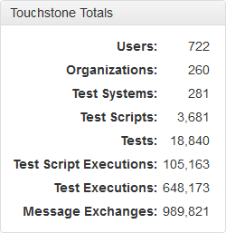
Touchstone Landing Page
Touchstone Totals: Tracks participation since Touchstone v1.0 release
Feeds: News links related to FHIR, Testing and Touchstone

Slide 19
Discussion (Q & A)
Notes:
Notes – try to keep Q&A to 5 mins. Additional discussion can be held at breaks, lunch, or after class. Also keep in mind that some of the questions may be answered in later sessions.

Slide 20
Getting Started with Touchstone
All testing participants need to first Register with Touchstone
Organizations may have 1 or more registered users on Touchstone (based on the organization’s subscription level)
Registration and acceptance of registration must be completed before any testing can begin
An organization will typically have at least 1 test system and may choose to run tests against other publicly available test systems

Slide 21
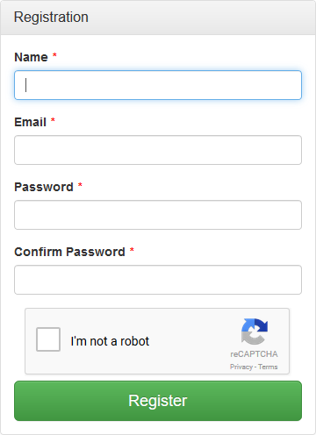
Register an Account in Touchstone
Click
Enter your user name, email, password twice, and select “I’m not a robot”
Click the Register button

Slide 22
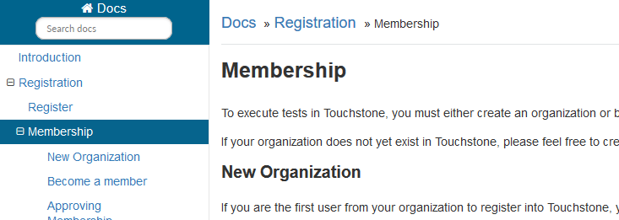
Create or Join an Organization
Your user account must belong to an organization. You can:
Create an organization with your team
Join an existing organization
Use the Online Documentation if guidance is needed

Slide 23
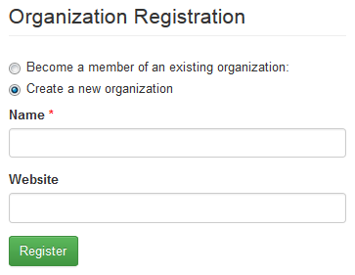
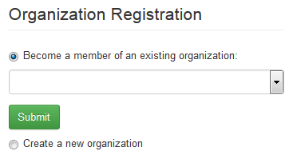
Create or Join an Organization
If you are the first person from your organization to register, select Create a new organization
If your organization is already registered, select Become a member of an existing organization. Then select your organization from the dropdown list.
Notes:
Student may define their own unique organization or use their company

Slide 24
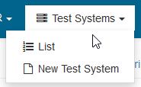
Create a New Test System Definition
To run tests, a Test System must be defined
From the top menu
Go to Test Systems
Select New Test System
Once selected, a new entry for Test System will display

Slide 25
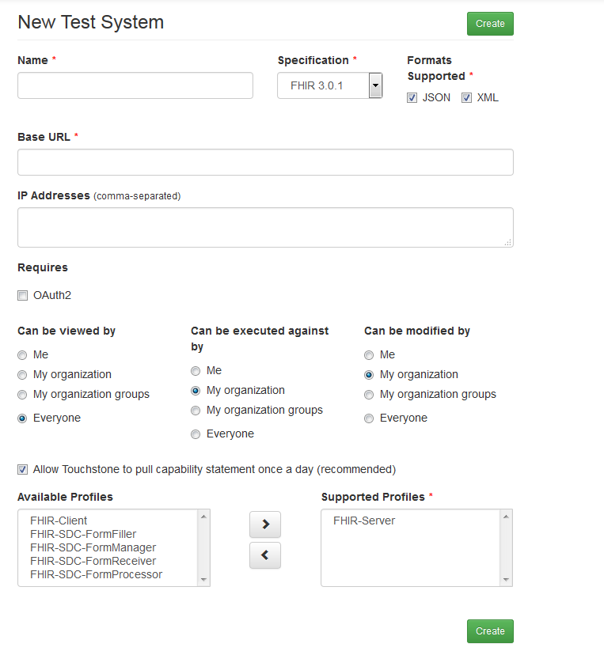
Create a New Test System Definition
Enter the test system name
Select the specification version and supported formats
Enter the base URL
The IP addresses are optional (Touchstone will determine this if left blank)
Select OAuth2 if required
Select privacy settings:
who the Test System can be viewed by
who can execute against the Test System
who can modify the Test System
Assign the supported actor profiles
Notes:
Student may use existing WildFHIR instance or their own server if publicly accessible.
http://wildfhir.aegis.net/fhir3-0-1-gui/index.jsf
Screenshot shows the defaults set when creating a new test system.

Slide 26

Touchstone Demo – Test Execution

Slide 27
Discussion (Q & A)
Notes:
Note – try to keep Q&A to 5 mins. Additional discussion can be held at breaks, lunch, or after class. Also keep in mind that some of the questions may be answered in later sessions.

